Slide 1
Example Stateless Session EJB

Slide 2
Example 02 index.html
<TR>
<TD> TIME </TD> <TD> <INPUT TYPE = TEXT NAME = "time"> </TD>
</TR>
<TR>
<TD> AMOUNT </TD> <TD> <INPUT TYPE = TEXT NAME = "amount"> </TD>
</TR>
<TR>
<TD> <INPUT TYPE = SUBMIT VALUE = "Calculate"> </TD>
</TR>
</TABLE>
</FORM>
</body>
</html>
<html>
<head>
<title>TODO supply a title</title>
<meta charset="UTF-8">
<meta name="viewport" content="width=device-width, initial-scale=1.0">
</head>
<body>
<FONT SIZE= 10 > <B> Calculate Interest </B> </FONT>
<FORM ACTION = "LoanServlet">
<TABLE>
<TR>
<TD> RATE </TD> <TD> <INPUT TYPE = TEXT NAME = "rate"> </TD>
</TR>

Slide 3
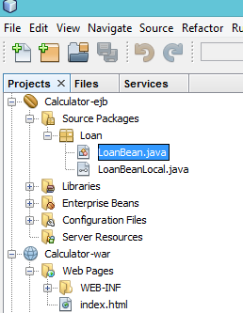
LoanBean
import javax.ejb.Stateless;
@Stateless
public class LoanBean implements LoanBeanLocal {
public float calculateInterest(float rate, float time, float amount) {
float interest = time * amount * (rate / 100);
return interest;
}
}

Slide 4
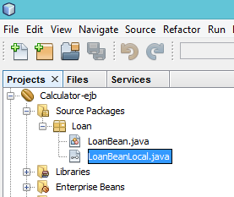
LoanBeanLocal
package Loan;
import javax.ejb.Local;
@Local
public interface LoanBeanLocal {
public float calculateInterest(float rate, float time, float amount);
}

Slide 5
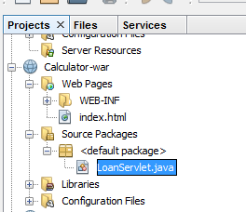
LoanServlet
import Loan.LoanBeanLocal;
import java.io.IOException;
import java.io.PrintWriter;
import javax.ejb.EJB;
import javax.servlet.ServletException;
import javax.servlet.annotation.WebServlet;
import javax.servlet.http.HttpServlet;
import javax.servlet.http.HttpServletRequest;
import javax.servlet.http.HttpServletResponse;
@WebServlet(urlPatterns = {"/LoanServlet"})
public class LoanServlet extends HttpServlet {
@EJB
private LoanBeanLocal LBean;
protected void processRequest(HttpServletRequest request, HttpServletResponse response)
throws ServletException, IOException {
response.setContentType("text/html;charset=UTF-8");
try (PrintWriter out = response.getWriter()) {
float rate=Float.valueOf(request.getParameter("rate")).floatValue();
float time=Float.valueOf(request.getParameter("time")).floatValue();
float amount=Float.valueOf(request.getParameter("amount")).floatValue();
out.println("<!DOCTYPE html>");
out.println("<html>");
out.println("<head>");
out.println("<title>Servlet LoanServlet</title>");
out.println("</head>");
out.println("<body>");
out.println("<h1>"+ LBean.calculateInterest(rate,time,amount) + "</h1>");
out.println("</body>");
out.println("</html>");
}
}

Slide 6
Example 03
@Stateless
public class CalculatorBean {
public int add(int a, int b) {
return a + b;
}
public int subtract(int a, int b) {
return a - b;
}
public int multiply(int a, int b) {
return a * b;
}
public int divide(int a, int b) {
return a / b;
}
public int remainder(int a, int b) {
return a % b;
}
}

